Slide 1
VLSI Testing
Bhargab B. Bhattacharya
(www.isical.ac.in/~bhargab)
Advanced Computing & Microelectronics Unit
and
Center for Soft Computing Research
Indian Statistical Institute, Kolkata
Notes:
Good Morning!
The title of today’s talk is “On some Planar Partitioning Problems”.

Slide 2
Testing and Verification
Faults models
  Stuck-at
  Delay
  Bridging
Test pattern generation
Built-in Self-Test (BIST)
Space and Time Compaction
Design for Testability (DFT)
Synthesis for Testability (SFT)
Low-power Testing
Verification and simulation

Slide 3
VLSI Testing
What is VLSI testing?
  VLSI testing is to test the behavioral correctness of a VLSI design.
  Three Phases:
    Design verification involves ascertaining logical correctness and timing behavior of the circuit through simulation
    Manufacturing tests check for the specific types of defects produced during fabrication
    Field test (day-to-day testing)

Slide 4
Structural Faults
x₂
G₁
G₃
x₃
x₁
G₅
G₂
z = (x₂+x₃)x₁ + x₁x₄
G₄
x₄
Lines stuck-at 1 and stuck-at 0
Input x₄ stuck-at 0, then z_{f} = (x₂+x₃)x₁
Any test vector with x₁= 0,x₄=1, i.e., any of the four tests
(0001,0011,0101,0111) detects this fault

Slide 5
Structural Faults – (2)
x₁
z₁=x₁x₂
f
x₂
z₂=x₂x₃
x₃
Bridging fault : short between two signal wires
OR-bridging fault f affects both outputs z₁ and z₂.
Test vector 011 detects f

Slide 6
Delay faults
0
0 1
z
1 0
1
Delay or timing faults in propagation of signal transitions

Slide 7
Fault Modeling
Why model faults?
Some real defects in VLSI and PCB
Common fault models
Stuck-at faults
    Single stuck-at faults
    Fault equivalence
    Fault dominance and checkpoint theorem
    Classes of stuck-at faults and multiple faults
Transistor faults

Slide 8
Common Fault Models
Single stuck-at faults
Transistor open and short faults
Memory faults
PLA faults (stuck-at, cross-point, bridging)
Functional faults (processors)
Delay faults (transition, path)
Analog faults

Slide 9
Single Stuck-at Fault
Three properties define a single stuck-at fault
    Only one line is faulty
    The faulty line is permanently set to 0 or 1
    The fault can be at an input or output of a gate
Example: XOR circuit has 12 fault sites ( ) and 24 single stuck-at faults
c
j
s-a-0
0(1)
a
d
g
1(0)
1
h
z
0
1
i
b
e
1
f
k
Test vector for h s-a-0 fault

Slide 10
Fault Equivalence
Fault equivalence: Two faults f1 and f2 are equivalent if all tests that detect f1 also detect f2
If faults f1 and f2 are equivalent then the corresponding faulty functions are identical

Slide 11
Equivalence Rules
sa0
sa0
sa1
sa1
sa0 sa1
sa0 sa1
WIRE
sa0 sa1
sa0 sa1
AND
OR
sa0 sa1
sa0 sa1
sa0
sa1
NOT
sa0
sa1
sa0 sa1
sa0 sa1
sa0 sa1
sa0 sa1
sa0
NAND
NOR
sa1
sa0 sa1
sa0
sa0 sa1
sa1
sa0
FANOUT
sa1

Slide 12
Fault Dominance
If all tests of some fault f1 detect another fault f2, then f2 is said to dominate f1
Dominance fault collapsing: If fault f2 dominates f1, then f2 is removed from the fault list

Slide 13
Dominance Example
All tests of F2
F1
s-a-1
001
110 010
000
101
100
F2
s-a-1
011
s-a-1
Only test of F1
s-a-1
s-a-1
s-a-0
A dominance collapsed fault set

Slide 14
Checkpoints
Primary inputs and fanout branches of a combinational circuit are called checkpoints
Checkpoint theorem: A test set that detects all single (multiple) stuck-at faults on all checkpoints of a combinational circuit, also detects all single (multiple) stuck-at faults in that circuit
Total fault sites = 16
Checkpoints ( ) = 10

Slide 15
Transistor (Switch) Faults
MOS transistor is considered an ideal switch and two types of faults are modeled:
    Stuck-open -- a single transistor is permanently stuck in the open state.
    Stuck-short -- a single transistor is permanently shorted irrespective of its gate voltage.
Detection of a stuck-open fault requires two vectors
Detection of a stuck-short fault requires the measurement of quiescent current (I_{DDQ})

Slide 16
Low-Power Built-in Self-Test (BIST)

Slide 17
Basic Concepts: Scan Design
Scan Design: is a design technique that makes it easy to test a sequential circuit by replacing the flip-flops with scan registers.
  Basic units of scan design
    Scan Register (shift register during testing)
    MUX
Primary
Inputs
Primary
outputs
Combinational Logic
Scan-in
Flip-Flops
Scan-out

Slide 18
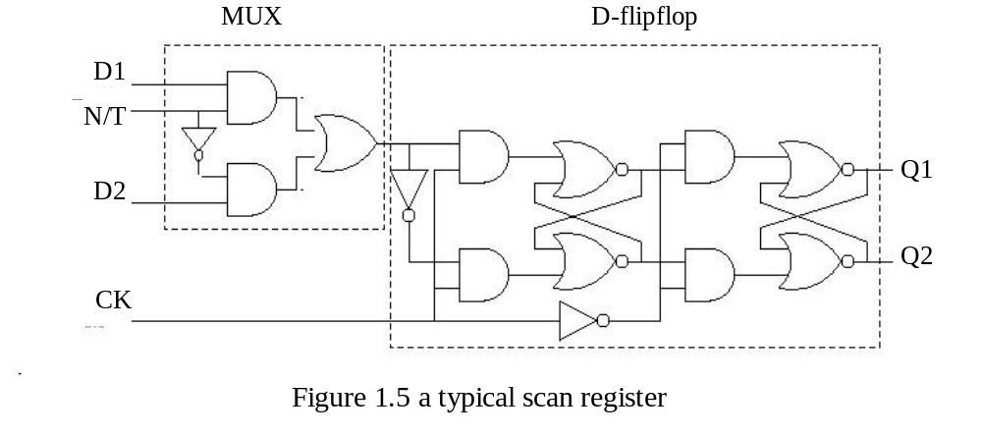
Basic Concepts: Scan Design
‾N/T: low, test mode, test vectors shifted in through D2
‾N/T: high, normal mode, data are shifted in through D1

Slide 19
Adding Scan Structure
PI
PO
Combinational
logic
SFF
SCAN-OUT
SFF
SFF
TC or TCK
SCAN-IN

Slide 20
Optimum Scan Layout
X
X’
IO
pad
SFF
cell
SCANIN
Flip-
flop
cell
Y
Y’
TC
SCAN
OUT
Routing
channels
Interconnects
Active areas: XY and X’Y’

Slide 21
What is BIST (Built-in Self-Test)?
  It is a design technique in which parts of a circuit are used to test the circuit itself
Test
Test Controller
ROM
Reference signature
TPG
Input
CUT
Response
Comparator
MUX
scan-path
compactor
Primary
Primary
Inputs
outputs
Good/faulty
Signature
Block diagram of BIST

